Slide 1

TEAM JABBERWOCKY
NAMITHA PADMANABHAN
N.R VINAY
RAM SRINIVAS
ROHAN SIMHA

Slide 2
PROBLEM STATEMENT TITLE
Gender Bias removal in Bollywood movie scripts
Done through the identification and replacement of biasing adjectives and occupations affiliated with the characters

Slide 3
ROLE OF EACH TEAM MEMBER
Namitha Padmanabhan - Used nltk and spacy to perform necessary chunking and identifying certain aspects of associated descriptions of characters. Worked on removal of dependent introductions and replacement of biased adjectives in the plot.
N.R Vinay - Extracting cast names and associating occupations with their names; Used Gensim Word2Vec to establish relevance of an occupation in the plot and further used the relevance score to deBias the occupation.
Ram Srinivas - Integrated code, created user interface, used Wikipedia Python API to determine gender of all cast members
Rohan Simha - Used spacy to perform a crude SRL on the coreferenced plots of the movies to identify the adjectives associated with a character, and their introduction removal and later in filtering the biasing adjectives.

Slide 4
TOOLS & APIs USED
Python 3.7
i) NLTK
ii) SpaCy
iii) Wikipedia API
iv) Flask
v) GenSim
HTML
CSS

Slide 5
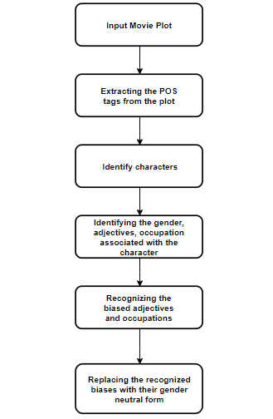
PROCESS FLOW DIAGRAM

Slide 6
FUNCTIONALITY
Recognition of the critical male and female characters to a plot
Recognizing the bias between them with respect to –
Introduction of the character
Occupation of the character
Adjectives associated with the characters
Replacement of the biased occupation and adjectives with suitable alternatives without disturbing the plot

